Slide 1
Number of Parameters and Tensor Sizes in a Convolutional Neural Network (CNN)
https://www.learnopencv.com/number-of-parameters-and-tensor-sizes-in-convolutional-neural-network/

Slide 2
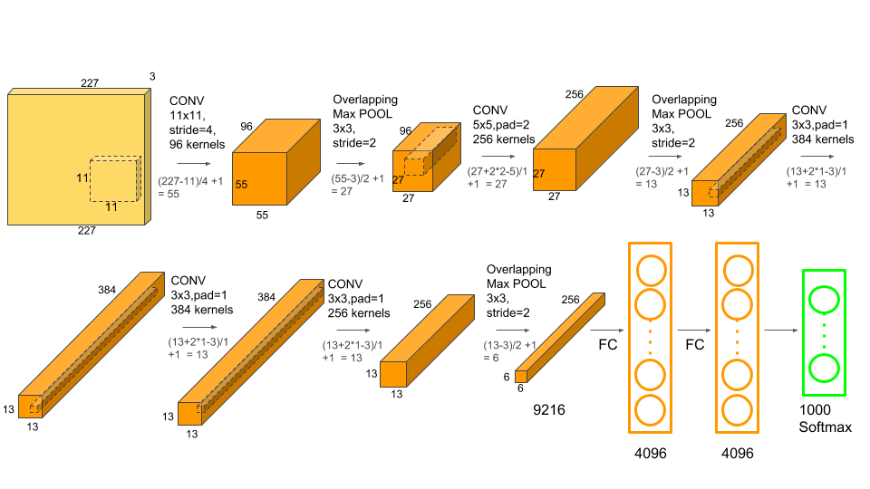

Slide 3
AlexNet has the following layers
Input: Color images of size 227x227x3. The AlexNet paper mentions the input size of 224×224 but that is a typo in the paper.
Conv-1: The first convolutional layer consists of 96 kernels of size 11×11 applied with a stride of 4 and padding of 0.
MaxPool-1: The maxpool layer following Conv-1 consists of pooling size of 3×3 and stride 2.
Conv-2: The second conv layer consists of 256 kernels of size 5×5 applied with a stride of 1 and padding of 2.
MaxPool-2: The maxpool layer following Conv-2 consists of pooling size of 3×3 and a stride of 2.
Conv-3: The third conv layer consists of 384 kernels of size 3×3 applied with a stride of 1 and padding of 1.
Conv-4: The fourth conv layer has the same structure as the third conv layer. It consists of 384 kernels of size 3×3 applied with a stride of 1 and padding of 1.
Conv-5: The fifth conv layer consists of 256 kernels of size 3×3 applied with a stride of 1 and padding of 1.
MaxPool-3: The maxpool layer following Conv-5 consists of pooling size of 3×3 and a stride of 2.
FC-1: The first fully connected layer has 4096 neurons.
FC-2: The second fully connected layer has 4096 neurons.
FC-3: The third fully connected layer has 1000 neurons.

Slide 4
Next, we will use the above architecture to explain
How to calculate the tensor size at each stage
How to calculate the total number of parameters in the network

Slide 5

Size of the Output Tensor (Image) of a Conv Layer
Let’s define
O = Size (width) of output image.
I = Size (width) of input image.
K = Size (width) of kernels used in the Conv Layer.
N = Number of kernels.
S = Stride of the convolution operation.
P = Padding.
The size (O) of the output image is given by
The number of channels in the output image is equal to the number of kernels N

Slide 6

Size of Output Tensor (Image) of a MaxPool Layer
Let’s define
O = Size (width) of output image.
I = Size (width) of input image.
S = Stride of the convolution operation.
P_s = Pool size.
The size (O) of the output image is given by
Note that this can be obtained using the formula for the convolution layer by making padding equal to zero and keeping P_s same as the kernel size.
But unlike the convolution layer, the number of channels in the maxpool layer’s output is unchanged

Slide 7
Size of the output of a Fully Connected Layer
A fully connected layer outputs a vector of length equal to the number of neurons in the layer.

Slide 8

Number of Parameters of a Conv Layer
In a CNN, each layer has two kinds of parameters : weights and biases.
The total number of parameters is just the sum of all weights and biases.
Let’s define,
Wc = Number of weights of the Conv Layer.
Bc = Number of biases of the Conv Layer.
Pc = Number of parameters of the Conv Layer.
K = Size (width) of kernels used in the Conv Layer.
N = Number of kernels.
C = Number of channels of the input image.

Slide 9

Example
Example: In AlexNet, at the first Conv Layer, the number of channels (C) of the input image is 3, the kernel size (K) is 11, the number of kernels (N) is 96. So the number of parameters is given by

Slide 10
Number of Parameters of a Fully Connected (FC) Layer
There are two kinds of fully connected layers in a CNN. The first FC layer is connected to the last Conv Layer, while later FC layers are connected to other FC layers. Let’s consider each case separately.

Slide 11

Case 1: Number of Parameters of a Fully Connected (FC) Layer connected to a Conv Layer
Let’s define,
Wcf = Number of weights of a FC Layer which is connected to a Conv Layer.
Bcf = Number of biases of a FC Layer which is connected to a Conv Layer.
O = Size (width) of the output image of the previous Conv Layer.
N = Number of kernels in the previous Conv Layer.
F = Number of neurons in the FC Layer.

Slide 12

Example
Example: The first fully connected layer of AlexNet is connected to a Conv Layer. For this layer, O = 6, N = 256 and F = 4096. Therefore,
That’s an order of magnitude more than the total number of parameters of all the Conv Layers combined!

Slide 13

Case 2: Number of Parameters of a Fully Connected (FC) Layer connected to a FC Layer
Let’s define,
Wff = Number of weights of a FC Layer which is connected to an FC Layer.
Bff = Number of biases of a FC Layer which is connected to an FC Layer.
Pff = Number of parameters of a FC Layer which is connected to an FC Layer.
F = Number of neurons in the FC Layer.
F-1 = Number of neurons in the previous FC Layer.
In the above equation, F-1 * F is the total number of connection weights from neurons of the previous FC Layer the neurons of the current FC Layer.
The total number of biases is the same as the number of neurons (F).

Slide 14

Example
The last fully connected layer of AlexNet is connected to an FC Layer. For this layer, F-1 = 4096 and F = 1000. Therefore,
We leave it for the reader to verify the total number of parameters for FC-2 in AlexNet is 16,781,312.

Slide 15
Number of Parameters and Tensor Sizes in AlexNet
The total number of parameters in AlexNet is the sum of all parameters in the 5 Conv Layers + 3 FC Layers. It comes out to a whopping 62,378,344! The table below provides a summary.
Layer Name | Tensor Size | Weights | Biases | Parameters
Input Image | 227x227x3 | 0 | 0 | 0
Conv-1 | 55x55x96 | 34,848 | 96 | 34,944
MaxPool-1 | 27x27x96 | 0 | 0 | 0
Conv-2 | 27x27x256 | 614,400 | 256 | 614,656
MaxPool-2 | 13x13x256 | 0 | 0 | 0
Conv-3 | 13x13x384 | 884,736 | 384 | 885,120
Conv-4 | 13x13x384 | 1,327,104 | 384 | 1,327,488
Conv-5 | 13x13x256 | 884,736 | 256 | 884,992
MaxPool-3 | 6x6x256 | 0 | 0 | 0
FC-1 | 4096×1 | 37,748,736 | 4,096 | 37,752,832
FC-2 | 4096×1 | 16,777,216 | 4,096 | 16,781,312
FC-3 | 1000×1 | 4,096,000 | 1,000 | 4,097,000
Output | 1000×1 | 0 | 0 | 0
Total |  |  |  | 62,378,344

